Slide 1
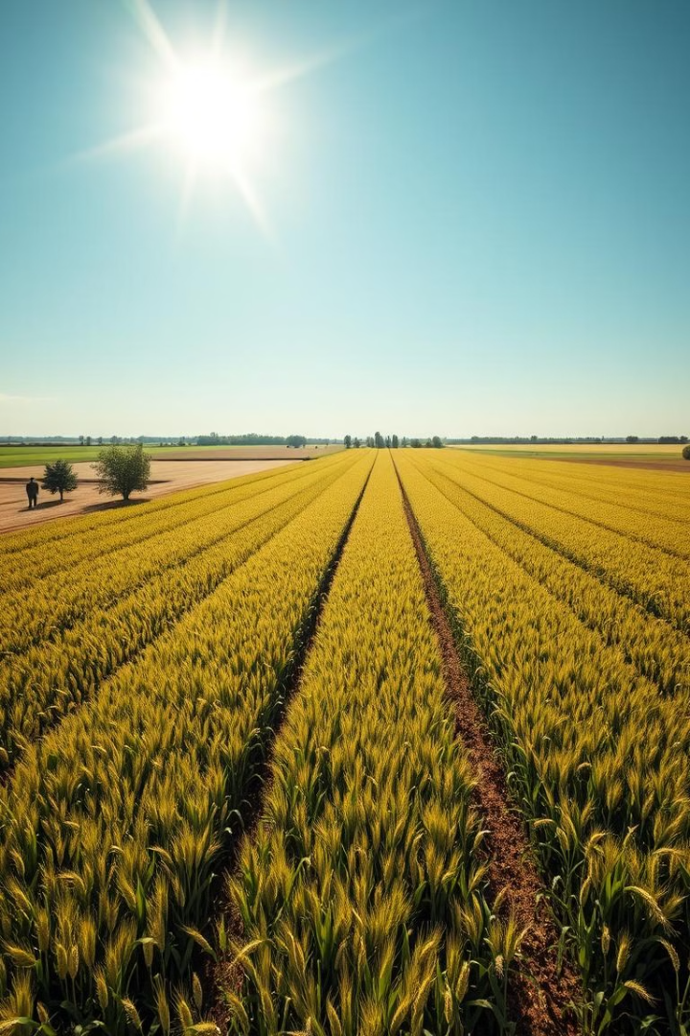
Demand Forecasting and Traceability System For Agricultural Products
TEAM NUMBER : 26 (CSE-B)
Automated Reasoning for Human Centered Interactive Systems
M. Tejaswi : 321136410117
N. Vinesh : 321136410126
K. Poojitha : 321136410137
M. Ram Sai Praneeth : 321136410072
GUIDED BY :
Dr. SANTOS KUMAR

Slide 2
ABSTRACT
Agricultural supply chains struggle with poor demand forecasting and weak product traceability, leading to imbalances, waste, and inefficiencies.
This allows farmers to grow the right crops at the right time, reducing surplus production and minimizing waste.
It also helps stabilize the agricultural supply chain by balancing supply with demand, ensuring fair pricing and higher profitability for farmers.
This approach enhances transparency by tracking the lifespan of crops, ensuring better quality control. Ultimately, it creates a more sustainable and efficient supply chain, benefiting both farmers and distributors.

Slide 3
Problem Statement
Farmers face the challenge of not receiving fair compensation for their crops as distributors purchase them at lower prices.
Due to market limitations, farmers cannot sell directly to consumers, resulting in reduced payments despite providing substantial quantities.
This creates an imbalance, leaving farmers at a financial disadvantage.

Slide 4
SRS TABLE:
S. No
Requirement ID
Requirement Name
Requirement Description
Essential/Desirable
1
REQ-001
Check Demand Forecast
The system must provide demand forecasts to help
Essential
farmers decide which crops to yield.
2
REQ-002
Fill Crop Details
The system must
Essential
allow farmers to enter crop details for
selling products.
3
REQ-003
Check Distributor Options
The system must show matching distributors for a farmer’s crops.
Essential
4
REQ-004
Fill Purchase Requirements
The system must
Essential
allow distributors to enter details of
needed crops.
5
REQ-005
Check Farmer Options
The system must show matching
Essential
farmers and their available crops to distributors.
6
REQ-006
Store Farmer and Distributor Entries
The system must store farmer and
Essential
distributor data in the database.

Slide 5
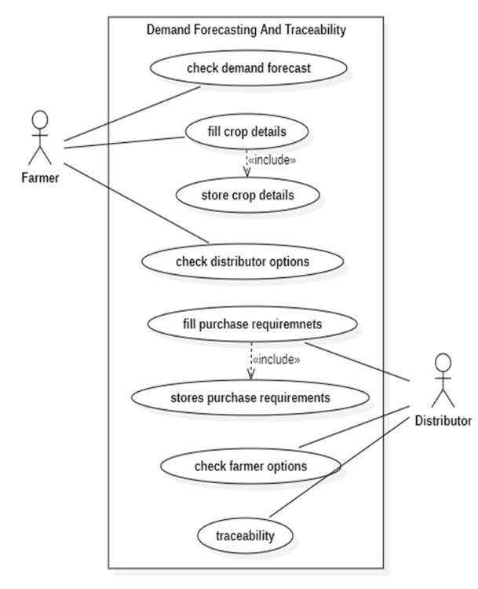
UML DIAGRAMS
USE CASE DIAGRAM :

Slide 6
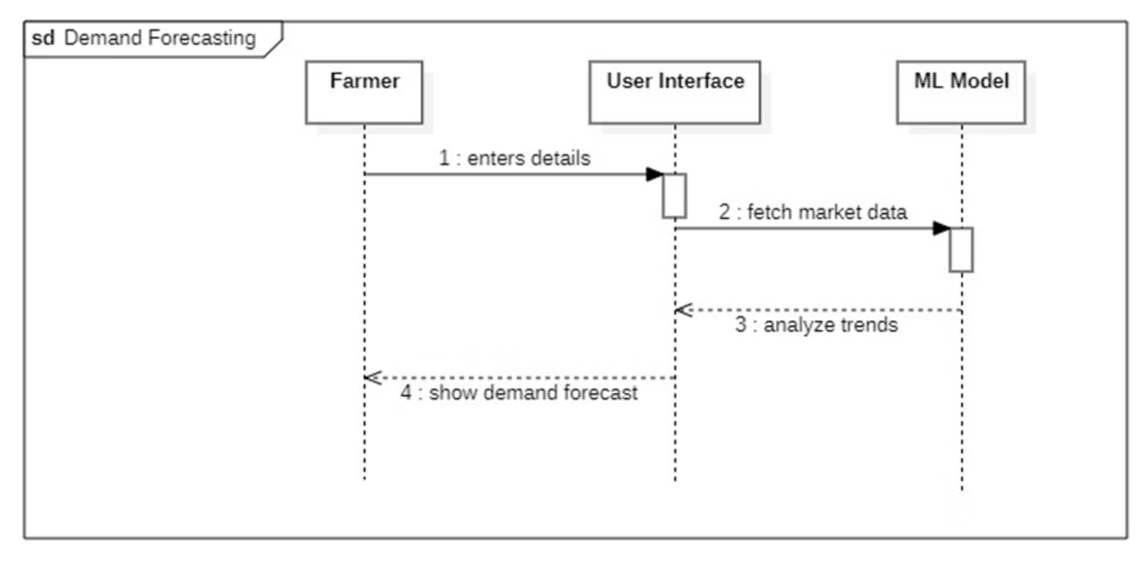
SEQUENCE DIAGRAM:
1. Sequence Diagram for Demand Forecasting :

Slide 7
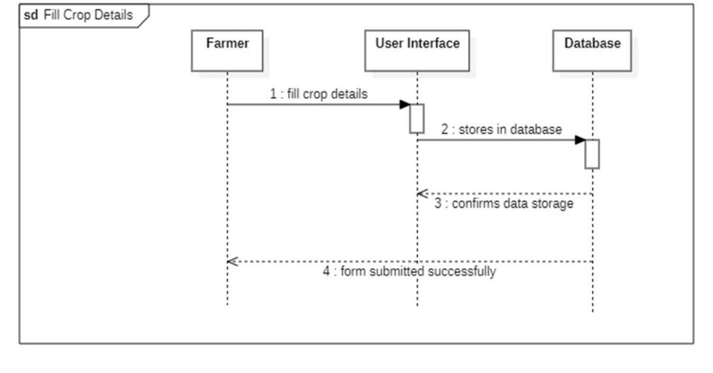
2. Sequence Diagram for Fill Crop Details :

Slide 8
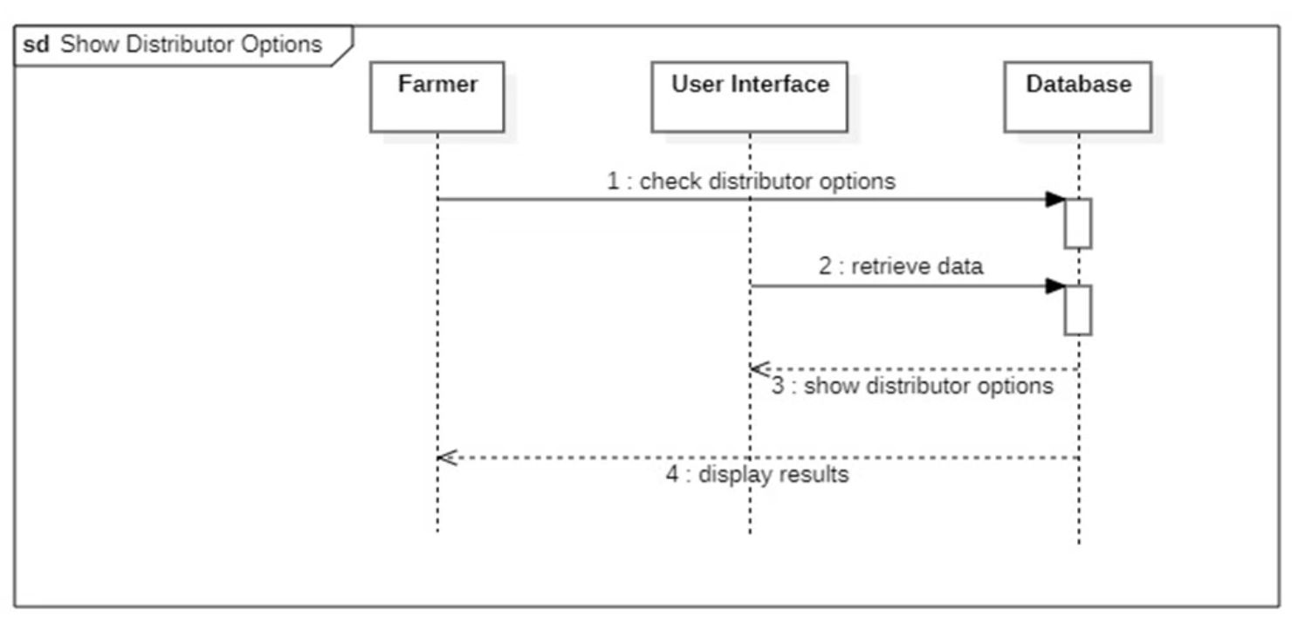
3. Sequence Diagram for show Distributor options :

Slide 9
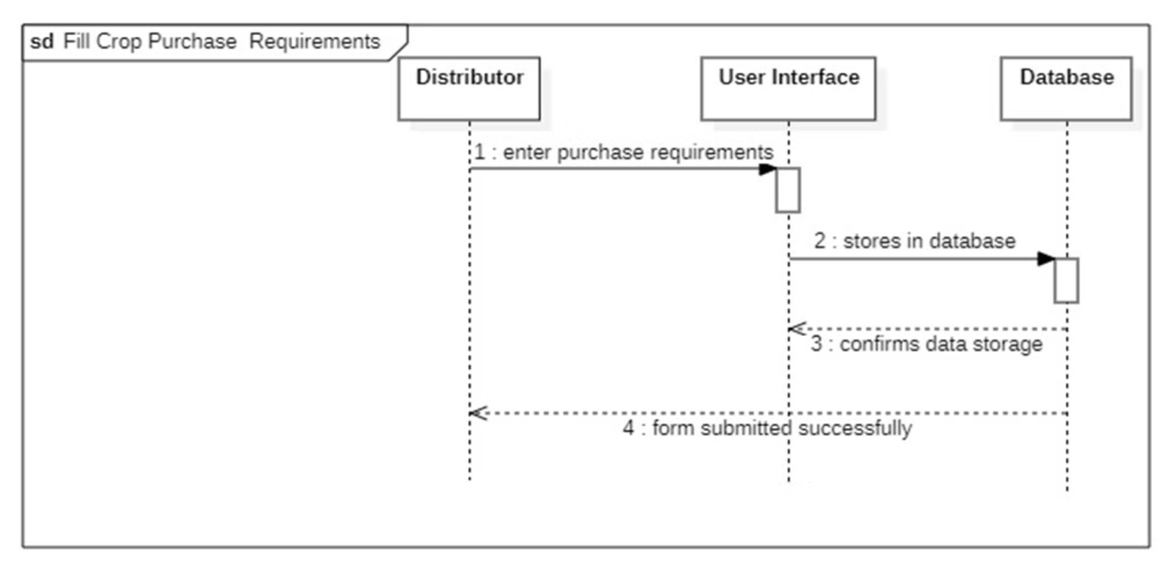
4. Sequence Diagram for fill crop purchase requirements :

Slide 10
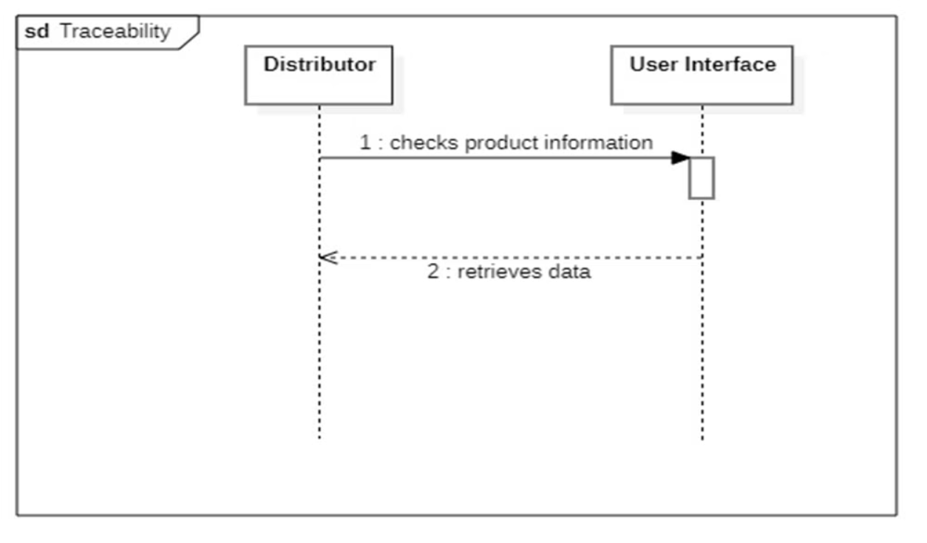
5. Sequence Diagram for Traceability :

Slide 11
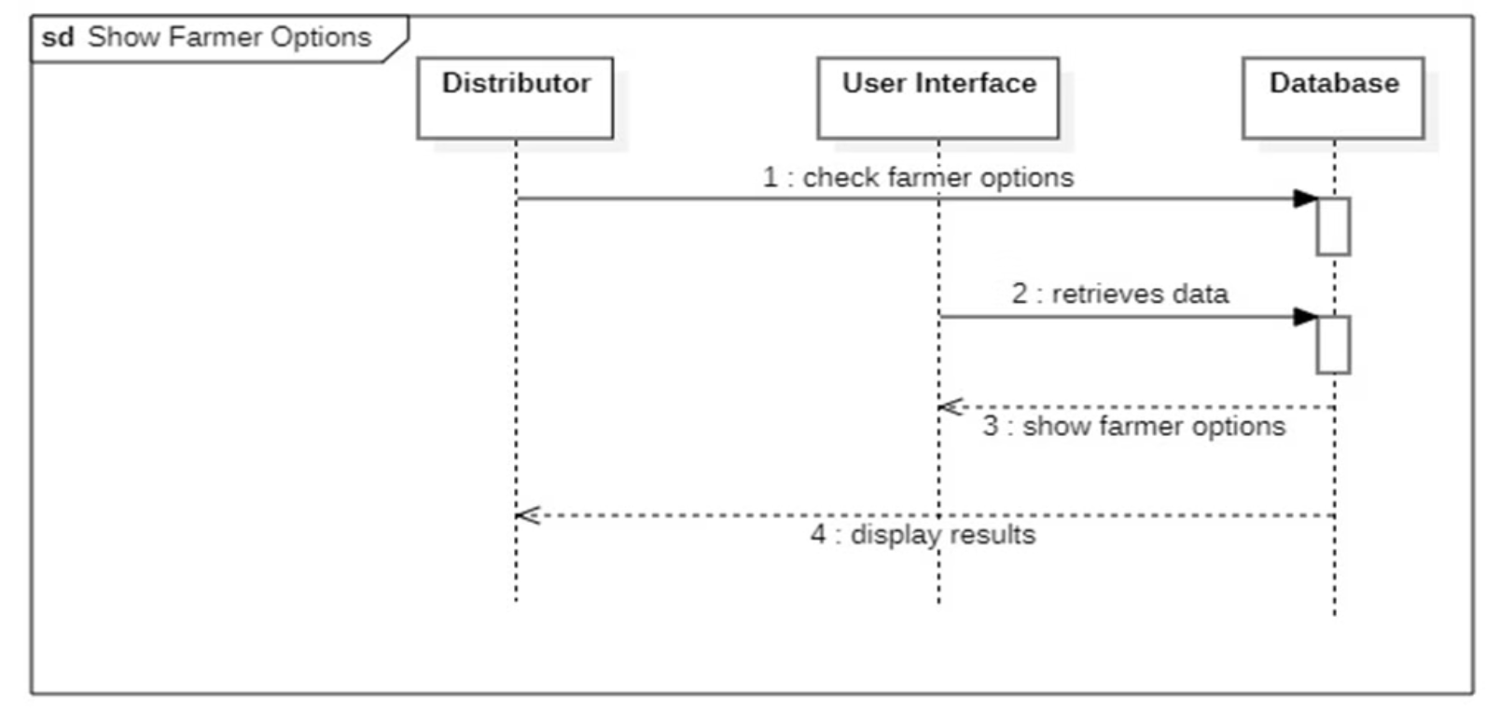
6. Sequence Diagram for show Farmer options :

Slide 12
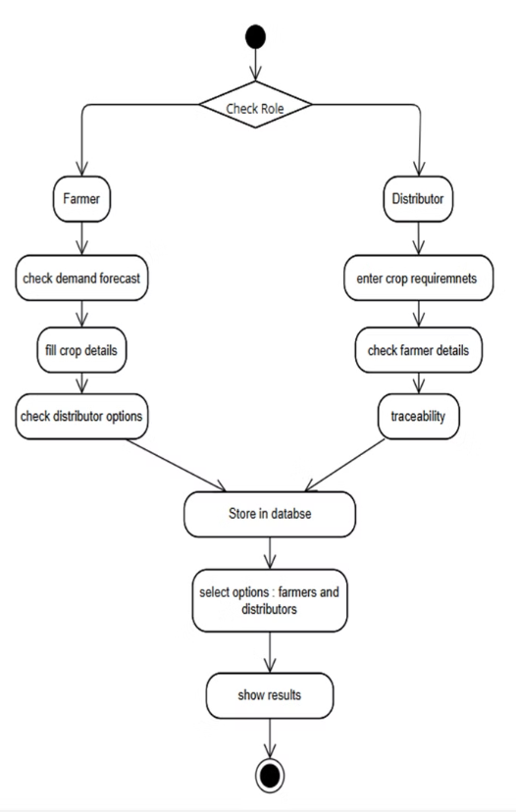
Activity Diagram:

Slide 13
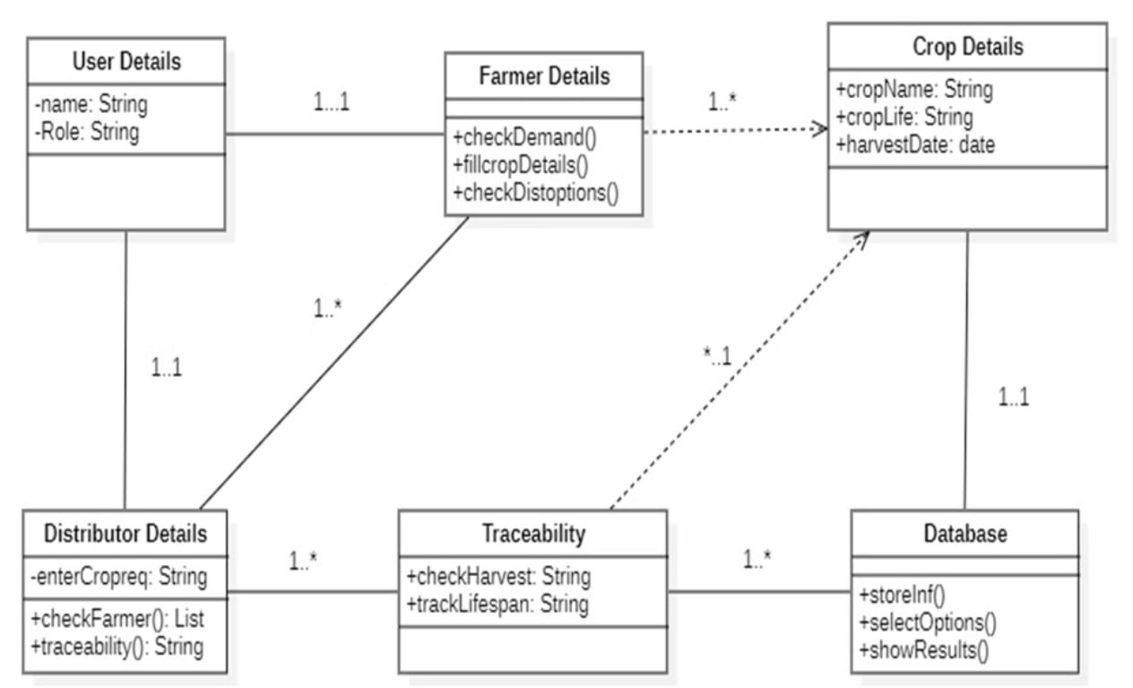
CLASS DIAGRAM

Slide 14
ALGORITHMS
Gradient Boosting Classifier:
Decision Tree Classifier:
Gradient descent is used to minimize the error in machine learning models by adjusting model parameters. It ensures accurate demand predictions by iteratively updating parameters to reduce the difference between predicted and actual demand values.
Decision trees split the data based on feature conditions (e.g., crop type, season, region) into smaller groups, allowing it to predict demand by understanding key variables affecting agricultural demand.
Unlike linear models, decision trees handle complex, non-linear relationships in agricultural data, such as the interplay between weather, soil type, and demand for specific crops.
By analyzing historical demand, weather, and economic trends, gradient descent helps train machine learning models to find patterns in the data, enabling them to predict future demand accurately.
Decision trees provide a clear, interpretable path to predictions. For example, they can show that high demand for "rice" occurs in specific regions during particular seasons, helping farmers make informed decisions about planting.
Gradient descent updates the model dynamically when new data is added, enabling real-time forecasting and responding to changes in market conditions, weather patterns, or consumer behavior.

Slide 15
Functional Test Cases :
1.Demand Forecasting Test Cases (Positive Test Cases)
Requirement ID
Testcase ID
Testcase Description
Test Priority
Pre-Requisite
Post-Requisite
DF_01
DF_1A
Demand Forecasting Positive Testcase
High
System has access to real-time and historical data
Accurate demand forecast displayed
S. No
Action
Input
Expected Output
Actual Output
Test Result
Test Comment
1
Predict demand based on historical data
Weather, soil, and market data
Accurate demand prediction displayed
Demand forecast displayed
Pass
Forecasting works as expected
2
Adjust forecast based on real-time data
Sudden climate change
Forecast updated correctly
Forecast updated correctly
Pass
System adapts to real-time data.

Slide 16
2.Demand Forecasting Test Cases (Negative Test Cases)
Requirement ID
Testcase ID
Testcase Description
Test Priority
Pre-Requisite
Post-Requisite
DF_02
DF_1B
Demand Forecasting Negative Testcase
High
No valid dataset available
Error message displayed
S. No
Action
Input
Expected Output
Actual Output
Test Result
Test Comment
1
Predict demand without data
No input
Error: "Insufficient data"
Error message displayed
Pass
Handles missing data correctly
2
Enter random non-relevant data
XYZ123, @#$%
Error: "Invalid input"
Error message displayed
Pass
Prevents incorrect inputs

Slide 17
3. Crop Details Entry Test Cases
Requirement ID
Testcase ID
Testcase Description
Test Priority
Pre-Requisite
Post-Requisite
CDE_01
CDE_1A
Crop Details Entry Positive Testcase
High
System allows data entry
Crop details successfully stored
S. No
Action
Input
Expected Output
Actual Output
Test Result
Test Comment
1
Enter valid crop details
Wheat, 100kg, $200
Crop details stored
Crop details stored
Pass
Data entry successfull.

Slide 18
4. Distributor Matching Test Cases
Requirement ID
Testcase ID
Testcase Description
Test Priority
Pre-Requisite
Post-Requisite
DM_01
DM_1A
Distributor Matching Positive Testcase
High
Farmers have entered crop details
Matching distributors displayed
S. No
Action
Input
Expected Output
Actual Output
Test Result
Test Comment
1
Find matching distributors
Wheat, 100kg
Matching distributors displayed
Matching distributors displayed
Pass
Matching works as expected

Slide 19
5.Purchase Requirements Entry Test Cases
Requirement ID
Testcase ID
Testcase Description
Test Priority
Pre-Requisite
Post-Requisite
PRE_01
PRE_1A
Purchase Requirements Entry Positive Testcase
High
System allows data entry
Purchase requirements successfully stored
S. No
Action
Input
Expected Output
Actual Output
Test Result
Test Comment
1
Enter valid purchase requirements
Rice, 500kg
Requirements stored
Requirements stored
Pass
Data entry successfull.

Slide 20
6.Farmer Matching Test Cases
Requirement ID
Testcase ID
Testcase Description
Test Priority
Pre-Requisite
Post-Requisite
PRE_01
PRE_1A
Purchase Requirements Entry Positive Testcase
High
System allows data entry
Purchase requirements successfully stored
S. No
Action
Input
Expected Output
Actual Output
Test Result
Test Comment
1
Find matching farmers
Rice, 500kg
Matching farmers displayed
Matching farmers displayed
Pass
Matching works as expected

Slide 21
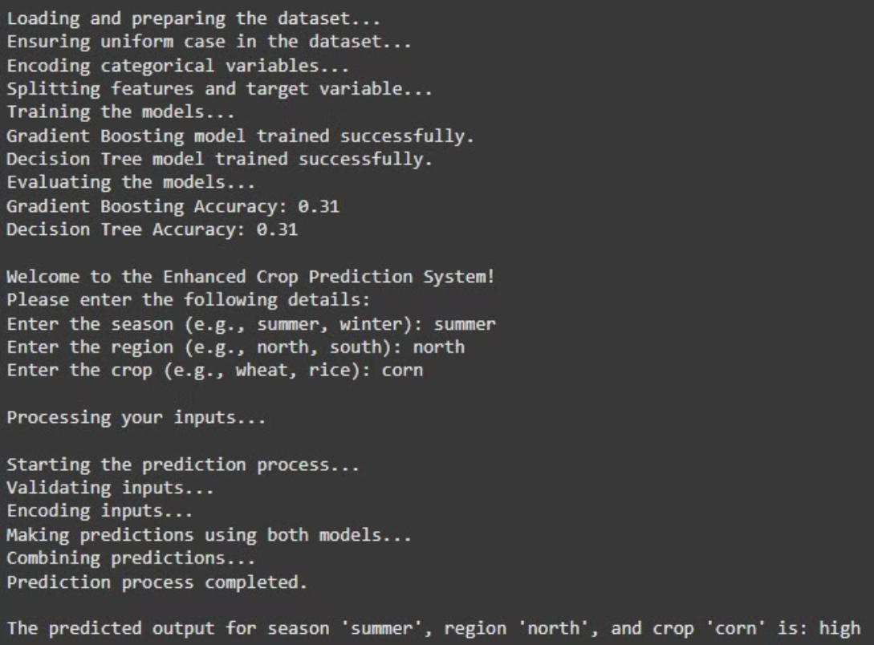
Execution

Slide 22
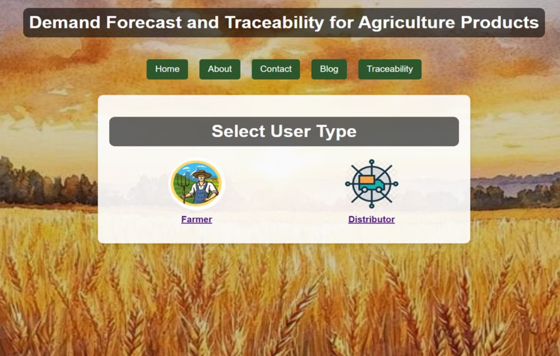
User Interface

Slide 23
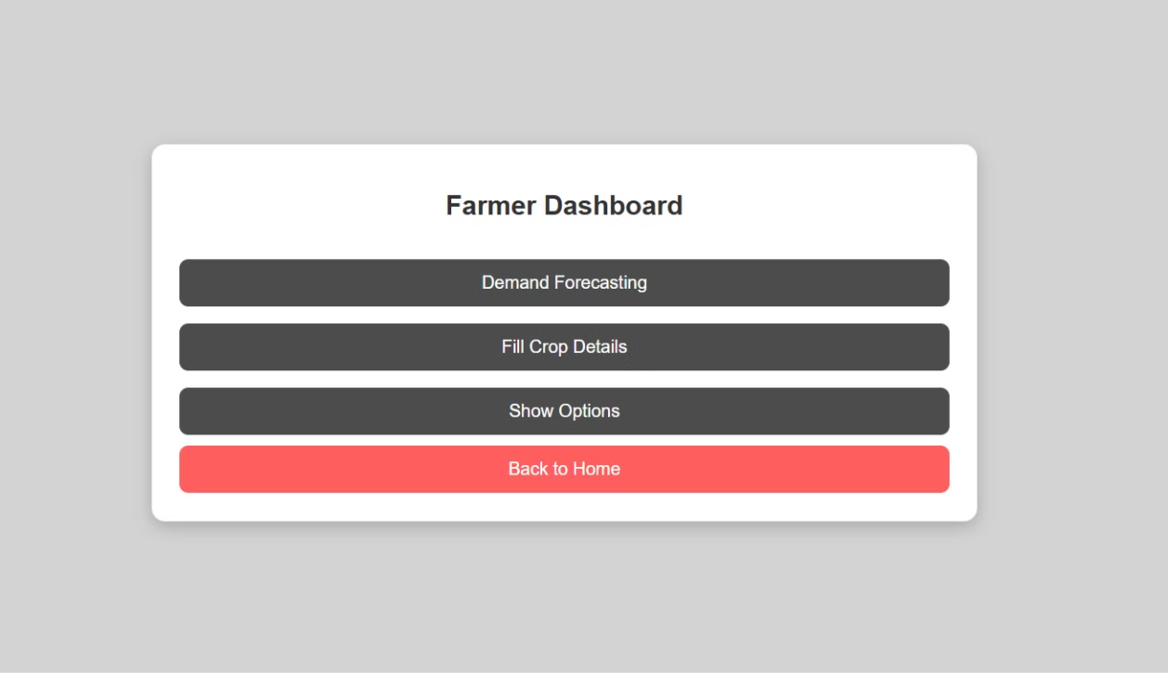
Farmer Dashboard

Slide 24
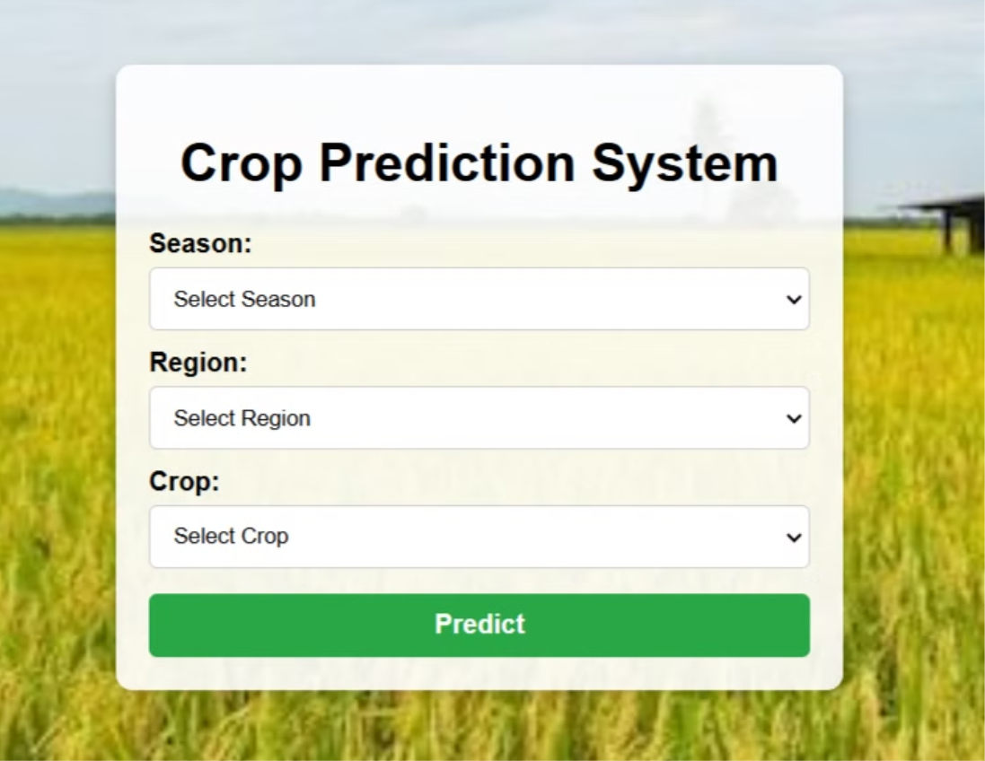

Slide 25
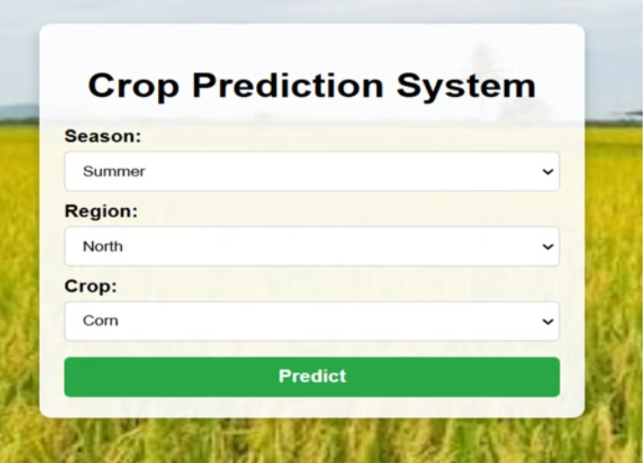
Demand Forecast page
INPUT :

Slide 26
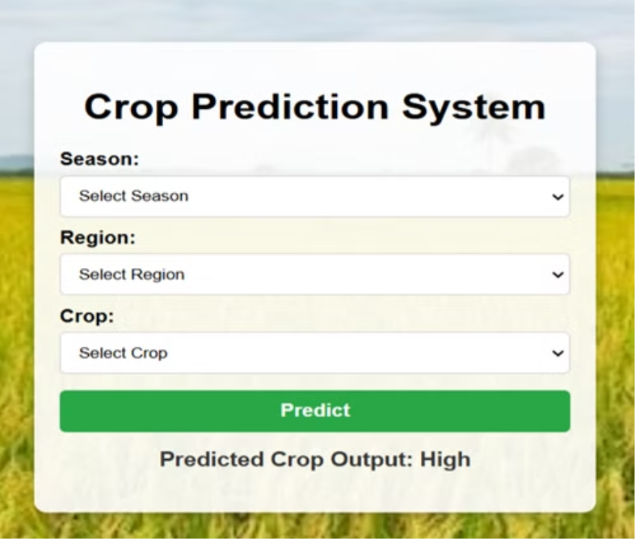
OUTPUT :

Slide 27
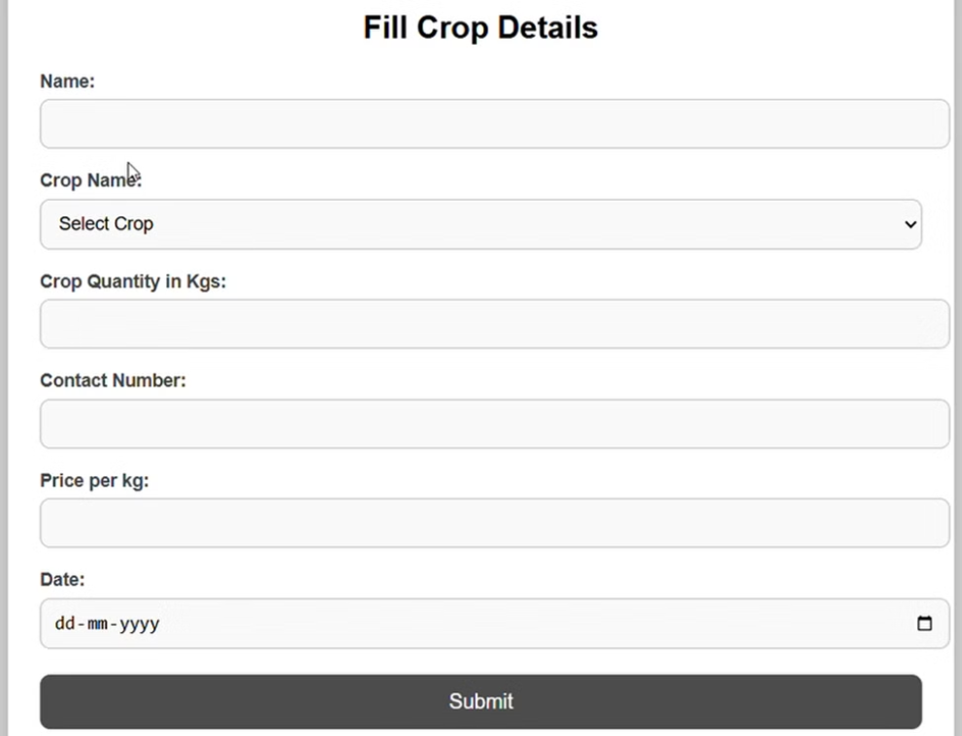
Fill Crop details

Slide 28
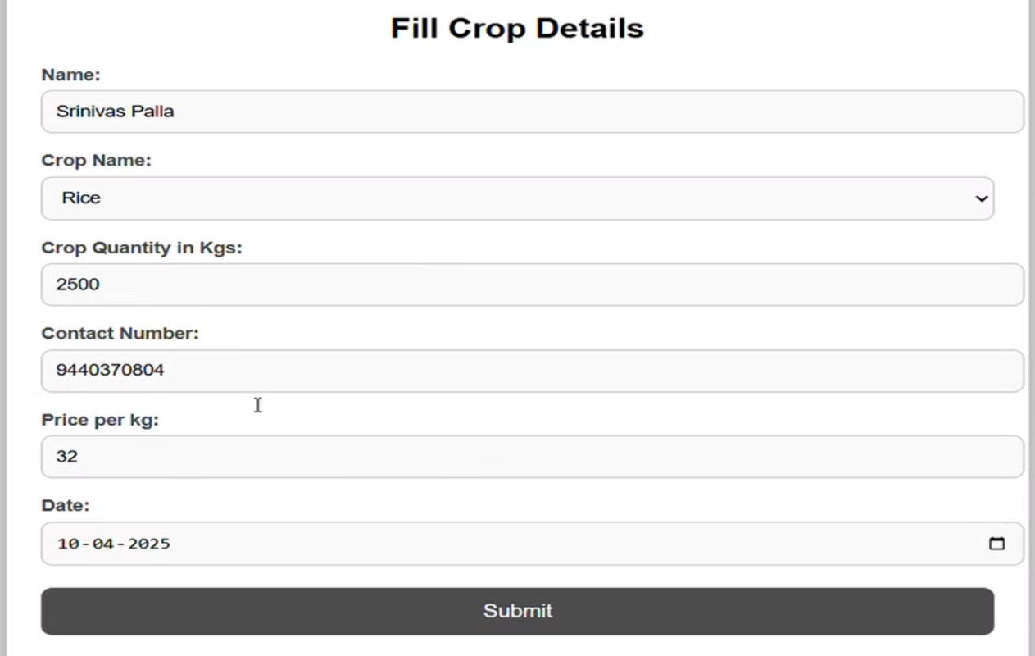

Slide 29
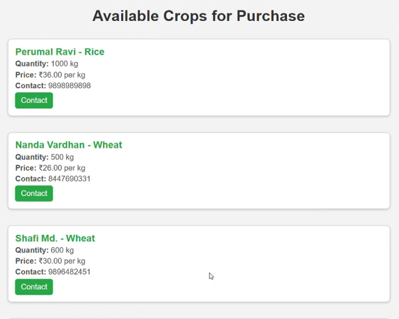
Options :

Slide 30
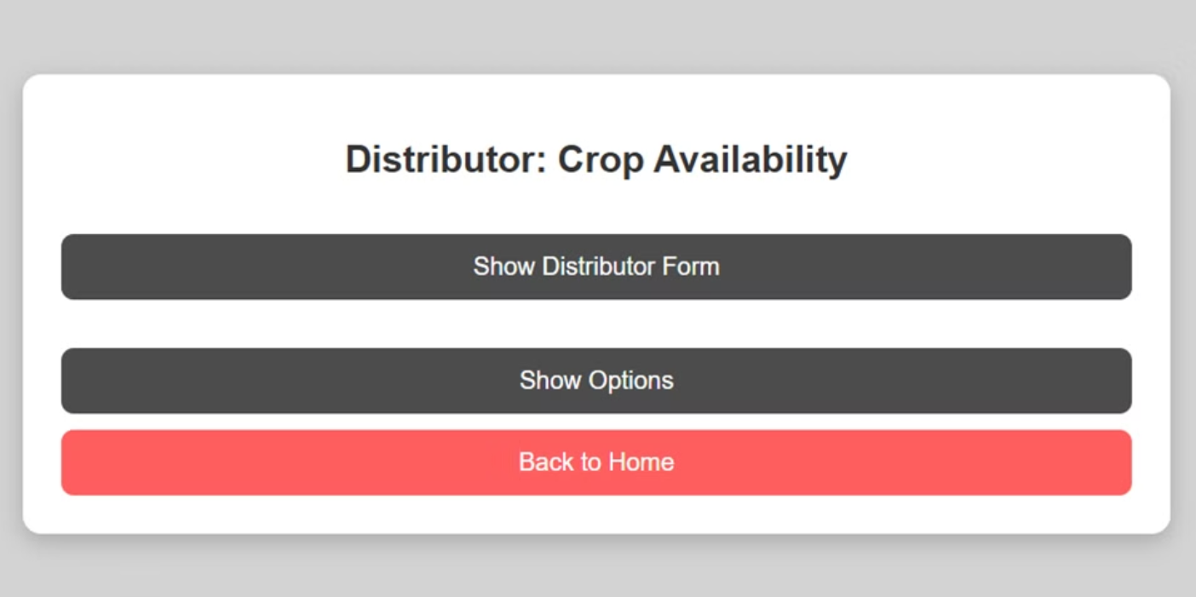
Distributor page

Slide 31
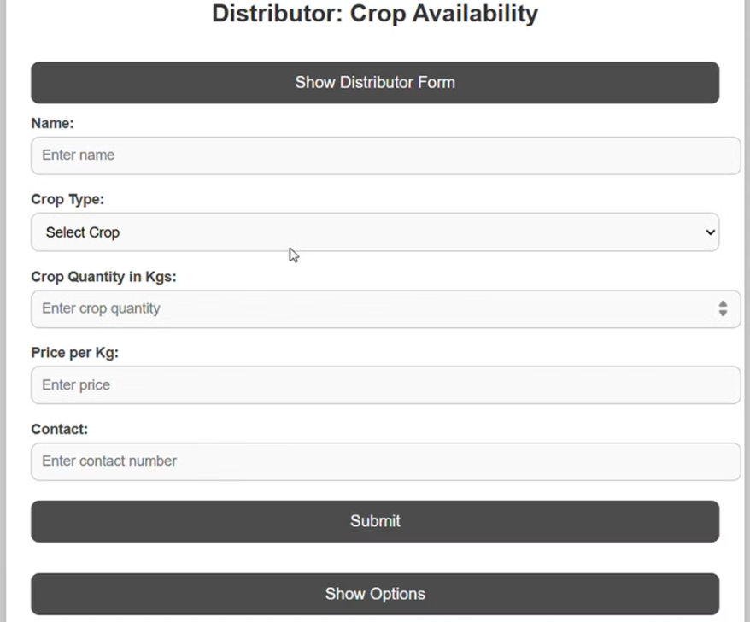

Slide 32
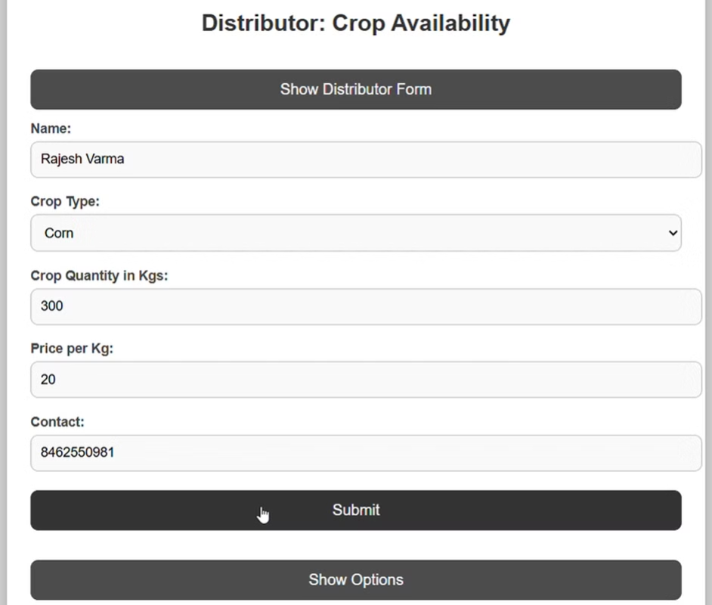

Slide 33
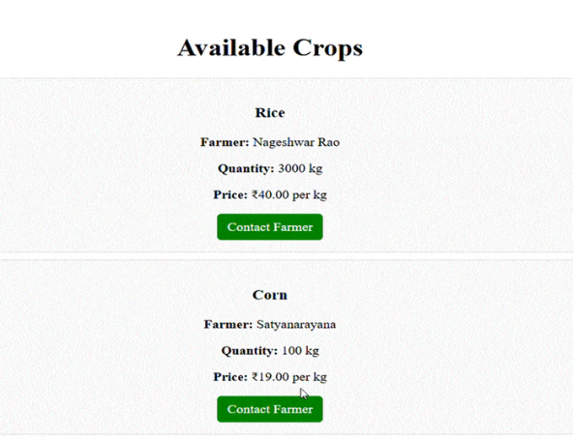
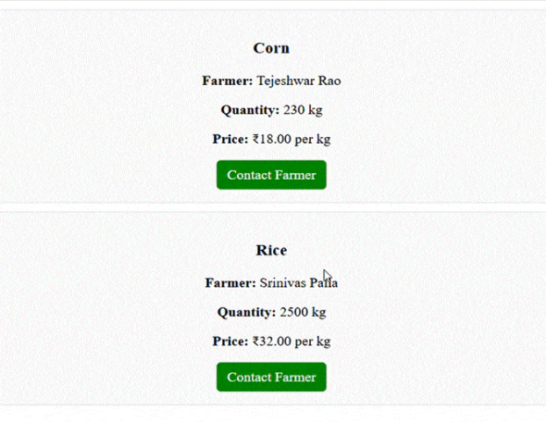
Options

Slide 34
CONCLUSION
Our approach aims to ensure that farmers receive fair compensation for their hard work by providing multiple distributor options.
Allowing them to get the correct price for their crop quantity.
By using machine learning for demand forecast , farmers make better decisions.
Additionally, by tracing the lifespan of crops, we can find ways to repurpose them for other uses, reducing waste and maximizing value.
Over all this contributes more efficient , balanced , farmer friendly supply chain.

Slide 35
Thank You

